Slide 1
P4 Intro
Mini Minecraft Planner

Slide 2
Mini Minecraft Planner
Given ingredients and a recipe → output crafted item
Planner to write:
Is it possible to create item with given ingredients within given time?
If so, what is the path, i.e. what do you craft first, what do you craft next?

Slide 3
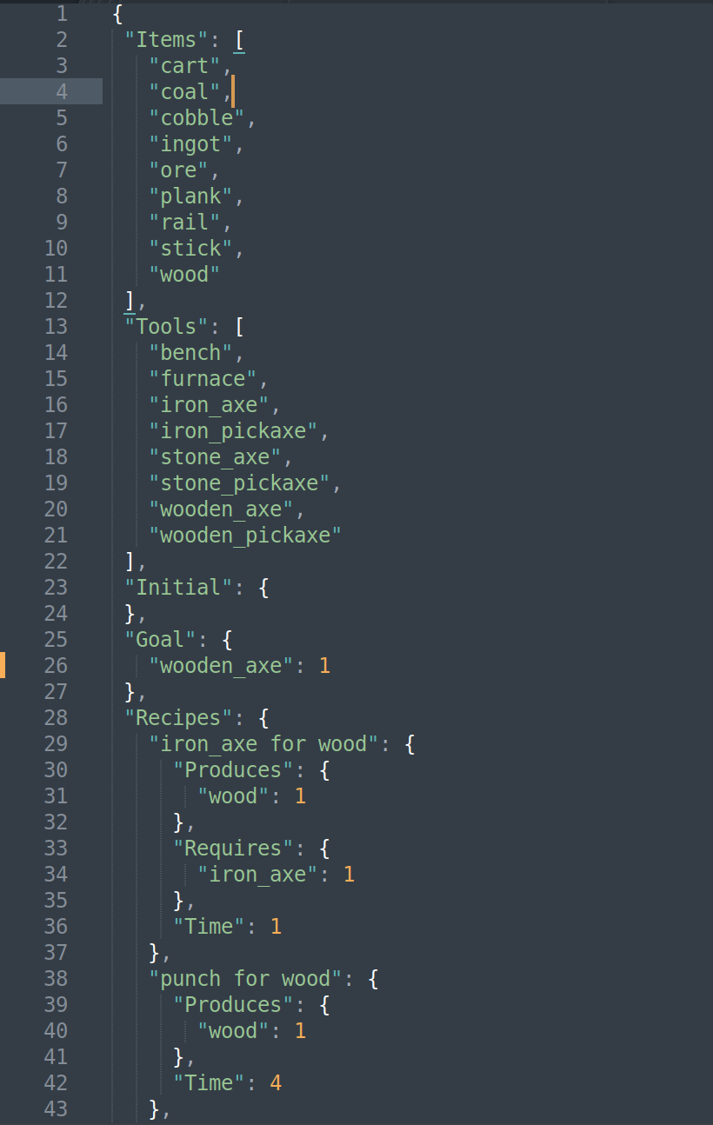
Files in this assignment
These files are provided for you. You should not edit these files, except for (optionally) the “Goals” in crafting.json for running.
crafting.json
Contains available item types
Contains crafting recipes
pyhop.py
HTN engine; we edited a few lines for 146 to enable adding ways to prune search branches using heuristics
travel.py
An example that showcases how pyhop works, that comes with pyhop (it still works with our small modification to pyhop)

Slide 4
Files in this assignment
def op_punch_for_wood (state, ID):
if state.time[ID] >= 4:
state.wood[ID] += 1
state.time[ID] -= 4
return state
return False
pyhop.declare_operators (op_punch_for_wood)
def produce (state, ID, item):
if item == 'wood':
return [('produce_wood', ID)]
def punch_for_wood (state, ID):
return [('op_punch_for_wood', ID)]
pyhop.declare_methods ('produce_wood', punch_for_wood)
def check_enough (state, ID, item, num):
if getattr(state,item)[ID] >= num: return []
return False
def produce_enough (state, ID, item, num):
return [('produce', ID, item), ('have_enough', ID, item, num)]
pyhop.declare_methods ('have_enough', check_enough, produce_enough)
pyhop.declare_methods ('produce', produce)
pyhop.pyhop(state, [('have_enough', 'agent', 'wood', 1)], verbose=3)
These files are frameworks for you to fill out with your code.
manualHTN.py
To ease you into using the pyhop HTN planner, understanding methods and operators
Methods can be understood as possible ways of subtasking a task
Operators can be understood as actual actions
"Recipes": {
"punch for wood": {
"Produces": {
"wood": 1
},
"Time": 4
},...

Slide 5
Files in this assignment
def op_punch_for_wood (state, ID):
if state.time[ID] >= 4:
state.wood[ID] += 1
state.time[ID] -= 4
return state
return False
pyhop.declare_operators (op_punch_for_wood)
def produce (state, ID, item):
if item == 'wood':
return [('produce_wood', ID)]
def punch_for_wood (state, ID):
return [('op_punch_for_wood', ID)]
pyhop.declare_methods ('produce_wood', punch_for_wood)
def check_enough (state, ID, item, num):
if getattr(state,item)[ID] >= num: return []
return False
def produce_enough (state, ID, item, num):
return [('produce', ID, item), ('have_enough', ID, item, num)]
pyhop.declare_methods ('have_enough', check_enough, produce_enough)
pyhop.declare_methods ('produce', produce)
pyhop.pyhop(state, [('have_enough', 'agent', 'wood', 1)], verbose=3)
These files are frameworks for you to fill out with your code.
manualHTN.py
To ease you into using the pyhop HTN planner, understanding methods and operators
Methods can be understood as possible ways of subtasking a task
Operators can be understood as actual actions
# declare state
state = pyhop.State('state')
state.wood = {'agent': 0}
state.time = {'agent': 4}
"Recipes": {
"punch for wood": {
"Produces": {
"wood": 1
},
"Time": 4
},...

Slide 6
Files in this assignment
def make_method (name, rule):
def method (state, ID):
# your code here
pass
return method
def declare_methods (data):
# your code here
pass
def make_operator (rule):
def operator (state, ID):
# your code here
pass
return operator
def declare_operators (data):
# your code here
pass
########################################
def add_heuristic (data, ID):
def heuristic (state, curr_task, tasks, plan, depth, calling_stack):
# your code here
return False # if True, prune this branch
pyhop.add_check(heuristic)
These files are frameworks for you to fill out with your code.
autoHTN.py
Methods and operators need to be defined programmatically
order methods for crafting the same item in a way that preferred methods come first in declare_methods (smart ordering is necessary for all but the simplest cases)
More difficult problem cases in assignment cannot be solved in reasonable time without pruning using add_heuristic

Slide 7
Note...
The state (a dict), list of tasks (a list), and the currently-accrued partial plan (a list) are passed up and down the search tree as essentially immutables because a new copy is passed each time
You can assume we only need one of each tool, and explicitly program this in heuristics; other heuristics should be general and not specific to recipes --- for example, nothing of the sort like: “if already have 16 wood, do not make more wood”
If your code takes longer than a few seconds to run, it is probably taking too long: check that your operators and methods are set up correctly, check that the ordering used in declare_methods is efficient, and check your heuristic

Slide 8
Submit
manualHTN.py (2 pt)
autoHTN.py (7 pt)
A README file that describes the heuristics you chose/programmed (1 pt)
(Optional Extra Credit) custom_case.txt that states the most complex problem your HTN planner can solve in 30 seconds of real-world time (1 pt)

Slide 9
Questions

